Slide 1
Hi, I’m your technical interviewer: Advice for breaking into industry
Paul Anzel
Senior Data Scientist
H-E-B
SciPy 2019

Slide 2
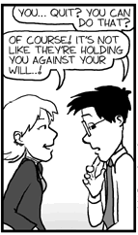
About me
Grad school in Applied Physics 2009-2016.
Left ABD for industry.
Was the right thing for me!
4 years apparently makes you “senior” in this business ;)
www.phdcomics.com

Slide 3
Hi, I’m your technical interviewer!
Submit resume
Initial resume screening
Phone interview with recruiter
On-site technical interview
Take-home assignment(?)
Offer (hopefully)
Hi!

Slide 4
Please, don’t make these mistakes
(I have made some of these mistakes)

Slide 5
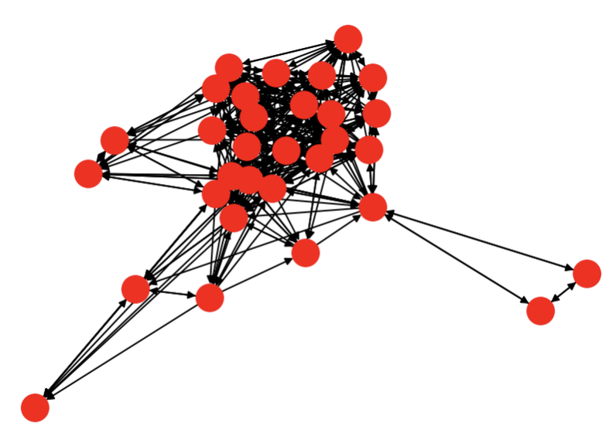
1. Not networking
Good job making it here, now meet people!
~80% of jobs don’t get posted.
I hate glad-handing. Finding hobbies, excuses to be social, and just getting out works.
Thanks, network analysis tutorial!

Slide 6
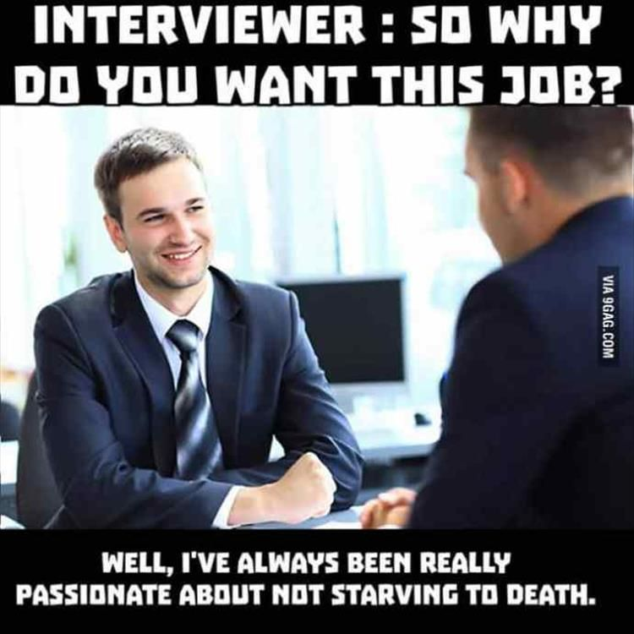
2. Not using referrals
Referrals can help you skip the first few steps in the process.
Sometimes referrers get a bonus for hires.
IMPORTANT: Once you know which positions you want, have your referrer submit your resume.
9gag.com

Slide 7
3. Not using exact job description language
Automated systems aren’t very smart.
Sometimes technical recruiters aren’t either.
Copy exact wording from job descriptions.
Original source unknown ☹

Slide 8
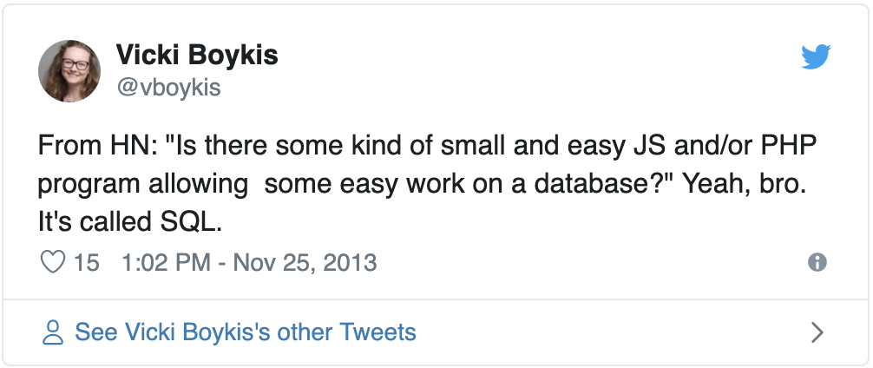
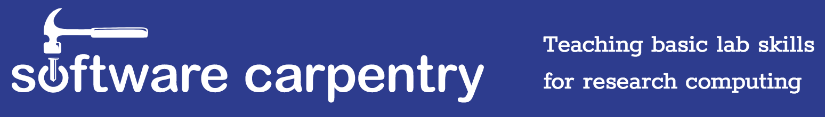
4. Not covering your bases
You’re probably in good shape, here at SciPy.
Make sure you understand SQL and version control.
Software Carpentry (+ extended lessons) is a good Minimum Viable Knowledge test.
Twitter link
https://software-carpentry.org/

Slide 9
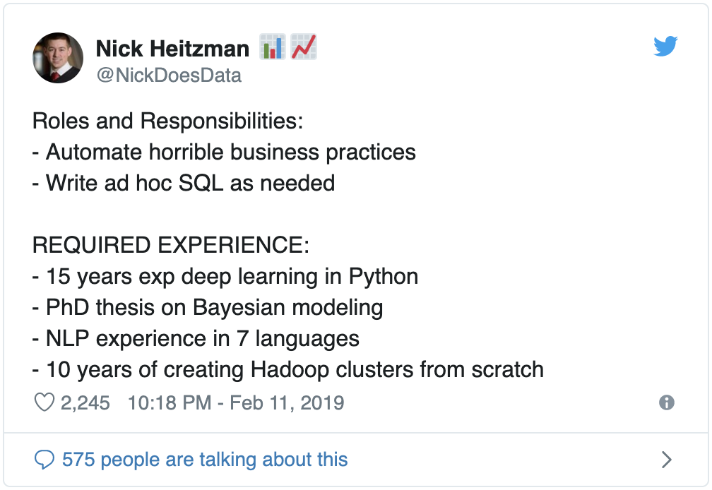
5. Worrying about every job line item
A few items are truly required, many (even “required”) ones are flexible.
A hit rate of 66-75% or so is good.
Twitter link

Slide 10
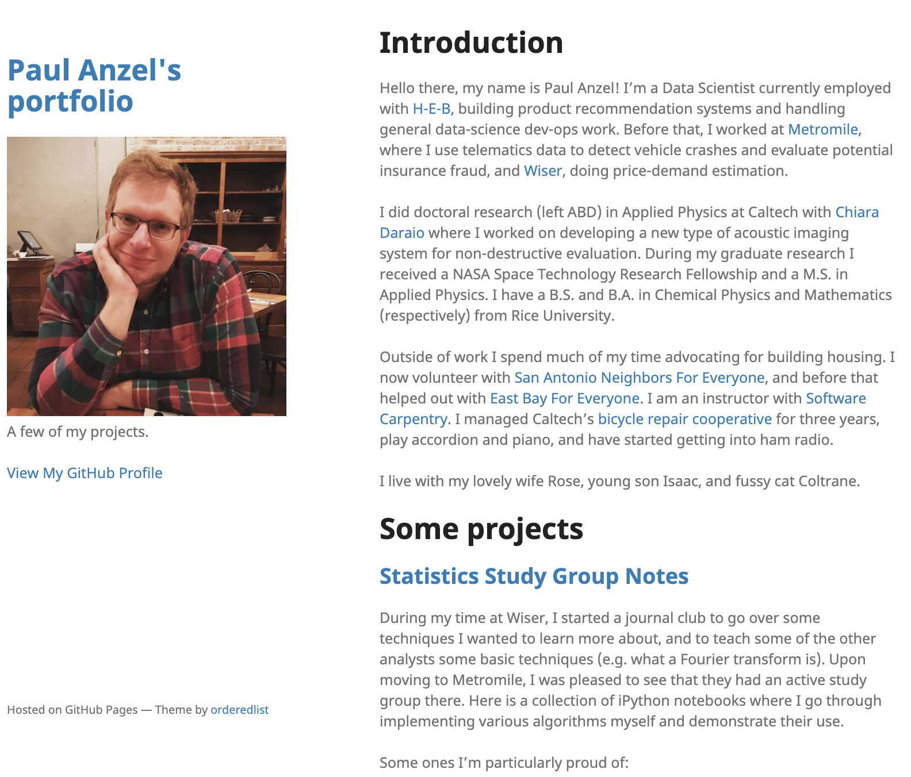
6. Not having a portfolio or blog
Please, give me something substantial to talk about!
Can you code? Communicate?
Fill in README’s. GitHub, BitBucket, and GitLab let you use Jekyll to create nice looking pages.
anzelpwj.github.io

Slide 11
Final bits
I’ll be in room 210 tomorrow 10-11 AM if anyone would like to get more advice.
https://cheekyscientist.com/blog/
https://www.nextscientist.com/
Linear Digressions podcast: Advice for those trying to get a first job in data science
http://anzelpwj.github.io/
https://cheezburger.com/8029803520

